Slide 1
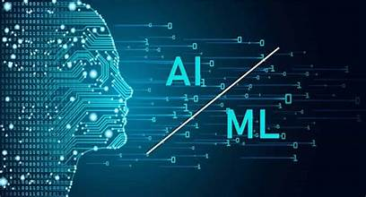
AWS AI-ML Virtual Internship
Presented By: InternshipIncharge:
G.Tejaswini Dr.Y.Rajesh
Y22CD037 Mr. K.Sai Prasanth

Slide 2
Contents :
Introduction .
Modules.
Modules Explanation.
Conclusion.
certificate.

Slide 3
Introduction :
Artificial Intelligence (AI):
AI is the ability of a machine or computer program to think and learn like humans. It can perform tasks such as problem-solving, decision-making, understanding language, and recognizing patterns.
Machine Learning (ML):
Ml is a subset of AI that enables machines to learn from data and improve over time without being explicitly programmed.

Slide 4
Modules :
Introducing Machine Learning.
Implementing a Machine Learning Pipeline with Amazon SageMaker.
Introducing Forecasting.
Introducing Computer Vision (CV).
Introducing Natural Language Processing (NLP).
Introducing Generative AI.

Slide 5
Introduction to machine learning :
Machine Learning (ML):
ML is a subset of AI that enables machines to learn from data and improve over time without being explicitly programmed.
ML applications are pervasive in our daily lives, from :
Spam filtering and email categorization.
Personalized product recommendations on e-commerce sites.
Advanced fraud detection systems in finance.

Slide 6
Pipeline with Amazon SageMaker :
Amazon SageMaker is a fully managed service that simplifies the entire machine learning workflow, from building and training to deploying ML models at scale.
Data preparation.
Feature Engineering.
Deployment & Hosting.

Slide 7
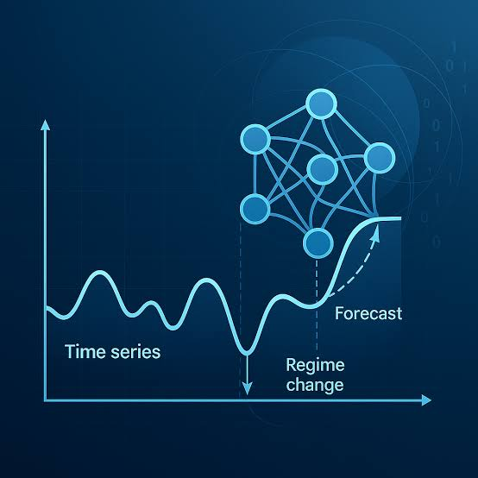
Introducing Forecasting :
Forecasting involves predicting future trends and events based on historical data, often time-series information.
Amazon Forecast automates complex machine learning tasks, enabling accurate predictions for various business needs, including:
Deand planning and inventory optimization.
Sales and revenue forecasting.
Resource allocation and workforce management.

Slide 8
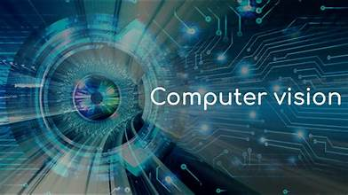
Introducing Computer Vision (CV) :
Computer Vision is a field of AI that trains computers to understand and process visual data from the real world, similar to how humans do. It transforms how businesses interact with visual information.
1.Visual Interpretation.
2.AWS Recognition.
3.Real-World Impact.

Slide 9
Introducing Natural Language Processing (NLP)
Natural Language Processing (NLP) is a branch of AI that equips machines with the ability to understand, interpret, and generate human language.
AWS provides a suite of NLP services:
Amazon Polly: converts text into lifelike speech.
Amazon Lex: builds conversational interfaces for applications.
Amazon Transcribe: transforms speech into text.

Slide 10
Introducing Generative AI :
Generative AI represents a groundbreaking area of AI that focuses on creating new, original content rather than just analyzing existing data.
1.Content Creation.
2.Design & Art.
3.Conversational Agents.

Slide 11
Conclusion :
Real-World Readiness: Gain the expertise needed to tackle diverse AI/ML challenges in various industries.
End-to-End Solutions: Learn to build and deploy comprehensive ML solutions, from data ingestion to model inference.
Continuous Growth: Foster a mindset of innovation and lifelong learning in the rapidly evolving field of AI.

Slide 12
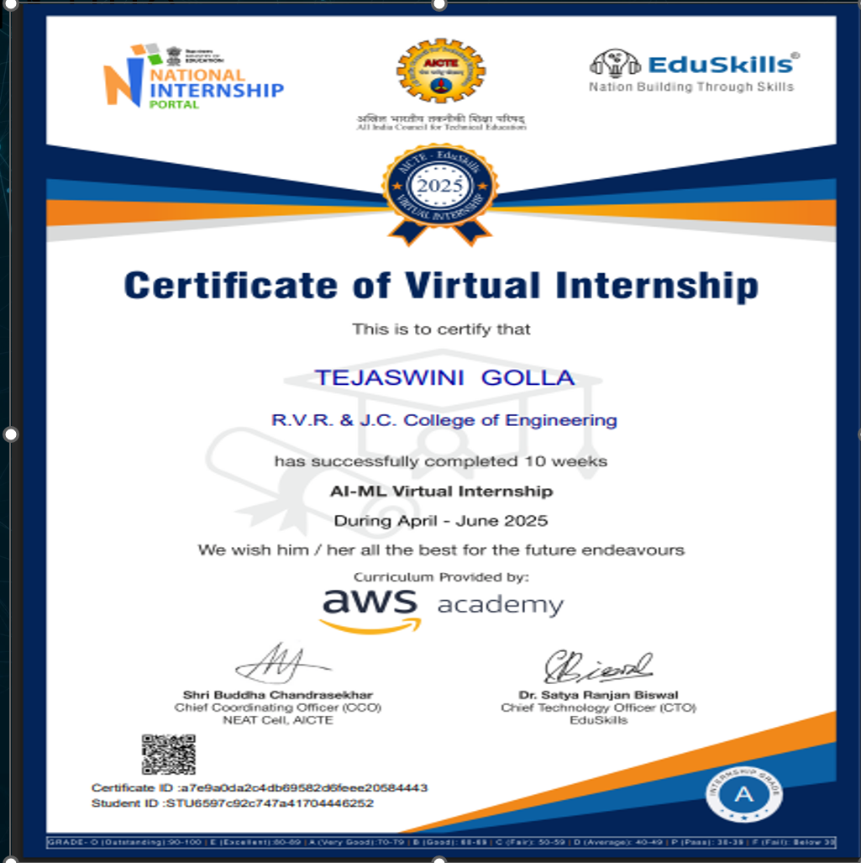
Certificate :

Slide 13
Thank you

